Slide 1
Healthy meals
16. First conditional

Slide 2
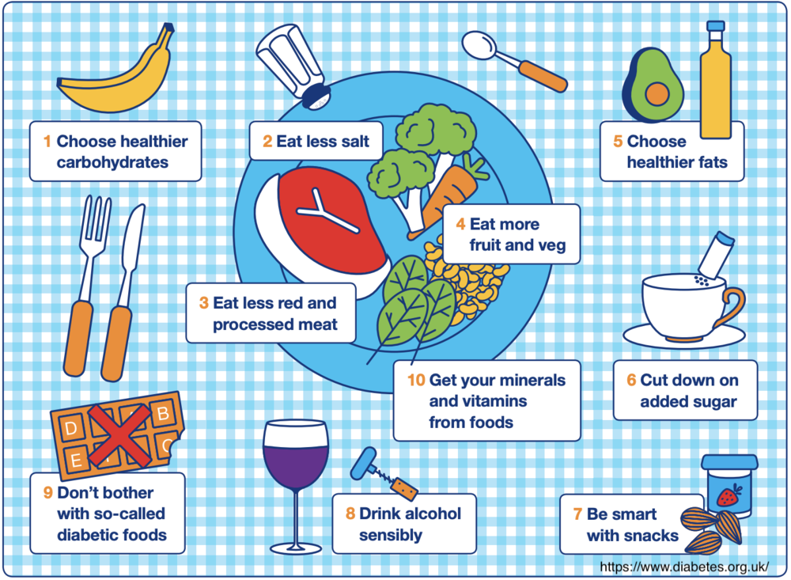
Healthy meals
Fill up on Fiber
Ditch Added Sugar
Walk Your Way to Health
Bring out Your Inner Chef
Have a Protein-Rich Breakfast
Don’t Drink Your Calories
Stay Hydrated
Lift Heavier to Get Lighter
Avoid Fad Diets
Don’t Deprive Yourself

Slide 3
First Conditional
First Conditional sentences talk about a future action or event (the result) that will probably take place if the condition is met.
Each sentence has two clauses: The conditional clause and the result clause.
The conditional clause is usually in the Present Simple.
The result clause is usually in the Future Simple.
The order of the two clauses is not important. However, when the conditional clause comes first, it must be followed by a comma.
If she goes on a diet, she will lose weight.
She will lose weight if she goes on a diet.
Notes:
Examples 1:41
https://www.youtube.com/watch?v=s59ygVYxpag

Slide 4
What will happen?
Pronouns to Use | Condition (present simple) | Result (future)
He | eat lots of junk food | gain weight
You | eat fish instead of red meat | be healthier
We | see a nutritionist | get help with a diet
They | take vitamins | improve health
The children | stop smoking | feel better
Peter | cut calories | lose weight
My mother | eat whole wheat bread instead of white | improve diet
I | drink eight glasses of water a day | feel healthy
Example: If he sees a nutritionist, he will improve his diet.

Slide 5
Time clauses with future meaning
The sentences below refer to the future. Each sentence has two clauses: the main clause in the future (result), and a time clause that begins with a time expression (condition).
After you stop smoking, you will feel healthier.
As soon as I start to exercise, I will lose weight.
I won’t eat any junk food until I finish my diet.
They will be home by the time we finish exercising.
Time Expressions
The verb after the time expression is in the Present Simple even though it talks about the future.
We often use the following time expressions in time clauses with future meaning:
after, by the time (that), until / till, as soon as, once, when, before, the moment (that)

Slide 6
Build sentences
The moment that Until As soon as After When Before Till
The moment you go on a diet, you will…
Pronouns to Use | Condition (present simple) | Result (future)
You | start to exercise every day | feel healthier.
I | go on a diet | lose ten kilograms.
We | exercise | lunch break starts.
They | finish work | have a healthy snack.
He | lose some weight | feel better.
She | eat some healthy fish and vegetables | go out.
The nutritionist | diet | tell us to stop.
Notes:
Until, till, and 'til are all used in modern English to denote when something will happen. Until and till are both standard, but what might be surprising is that till is the older word. 'Til, with one L, is an informal and poetic shortening of until. The form 'till, with an additional L, is rarely if ever used today.

Slide 7
First conditional (without if)
We often use the word unless instead of if ... not. Unless is always followed by the positive form of the verb.
Unless you have a plan, you will panic. = If you don’t have a plan, you will panic
The conditional clause starts with unless. The order of the two parts is not important. However, when the conditional clause comes first, it must be followed by a comma.
Unless you take a first aid course, you won’t help anybody.
You won’t help anybody unless you take a first aid course.
Notes:
https://www.youtube.com/watch?v=b3dOjd670Kc

Slide 8
Complete the sentences
Unless I eat a balanced diet, ________.
Unless you include fruits and vegetables in your diet, ________.
Unless he exercises regularly, ________.
Unless we limit our consumption of processed food, ________.
Unless you drink enough water, ________.
Unless Jenny controls her portion sizes, ________.
Unless the doctor checks my cholesterol, ________.
Unless the nutritionist recommends it, ________.
Unless people limit their sodium intake, ________.
Unless our coworkers cook at home, ________.

Slide 9

Realistic goals
Think about the goals you want to achieve.
Tell us your plans on how to achieve them.
Examples:
If I want to get enough sleep, I will turn of the tv at 9 pm.
Unless I have my water closeby, it will be hard to stay hydrated.

